Slide 1



REGROUP
A Prospective, Randomized Trial Comparing Endoscopic vs. Open Vein Grafts in
CABG Surgery
Marco A Zenati MD
Deepak L. Bhatt, Faisal G. Bakaeen, Eileen M. Stock, Kousick Biswas, J. Michael Gaziano, Rosemary F. Kelly, Elaine E. Tseng, Jerene Bitondo, Jacquelyn A. Quin, G. Hossein Almassi, Miguel Haime, Brack Hattler, Michael Jessen, Ellen DeMatt, Alexandra Scrymgeour, Grant D. Huang
for the REGROUP Trial Investigators
NCT01850082

Slide 2

Saphenous Vein-Graft
The Most Common
Conduit for CABG
Endoscopic Vein Harvest

Slide 3
Safety of Endoscopic Harvest in CABG
DCRI 2009

Slide 4

Randomized Endovein Graft Prospective (REGROUP) Trial
VA Cooperative Studies Program (CSP) #588 [2013]
REGROUP Design Imperatives:
EVH Harvester Expertise
Large enough for a meaningful primary outcome:
  MACE: composite of Death, MI or Repeat Revascularization

Slide 5
REGROUP - Major Inclusion Criteria
Indication for CABG using at least 1 vein graft
On-pump; No associated procedure
Elective or urgent surgery
Availability of an expert EVH harvester
  >100 EVH; <5% Conversion; EVH Program >2 years

Slide 6
REGROUP
3394 pts with CAD and indication for CABG
1150
R
ENDOSCOPIC
(N=576)
OPEN
(N=574)
EVH
OVH

Slide 7
Characteristics of the Patients (N=1150)
 | EVH (N=574) | OVH (N=576)
Age (years) | 66.2 ± 6.7 | 66.6 ± 7.1
Male | 99.5% | 99.5%
BMI (kg/m²) | 30.3 ± 5.2 | 30.6 ± 5.2
Hyperlipidemia | 85.4% | 87.5%
Peripheral vascular disease | 13.9% | 13.9%
Prior myocardial infarction | 38.1% | 36.1%
Diabetes | 48.8% | 51.7%
- Insulin-treated | 21.7% | 23.9%
Hypertension, medically treated | 90.6% | 89.7%
NYHA Class III-IV | 10.1% | 12%
Current smoker | 28.5% | 26.3%
Prior PCI | 27.8% | 27.5%
Prior stroke | 8.3% | 8.4%

Slide 8
CABG Procedure
Off-pump CABG | 0.5%
Cardiopulmonary bypass time (min) | 108.4 ± 35.8
Cross clamp time (min) | 76.1 ± 30.8
STS PROM (%) | 0.94 ± 0.86
Vein harvest time (min) | 59.4 ± 26.7
EVH harvest time (min)* | 57.5 ± 24.4
OVH harvest time (min) | 61.4 ± 28.7
# Grafts per pt | 3.1 ± 0.8
Bilateral ITA | 10.3%
Radial artery | 1.1%
SYNTAX score | 28.5 ± 11.5
Days from randomization to CABG | 0.1 ± 1.7
LVEF (%) | 54 ± 9.9
Conversion from EVH to OVH (%) | 5.6%
Urgent CABG | 27%

Slide 9
No Difference in Major Adverse Cardiac Events during Active Follow-up (median 2.78 yrs)
Patients, %
N=1150

Slide 10
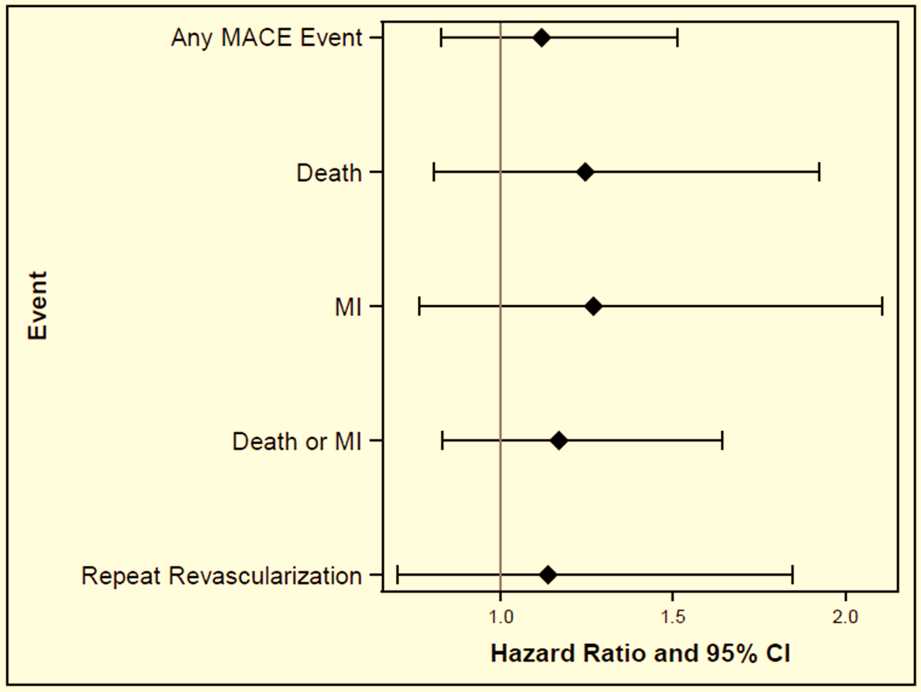
Hazard Ratio for
Major Adverse Cardiac Events
OPEN Better
ENDOSCOPIC Better
HR and 95% CI

Slide 11
K-M for MACE over Active Follow-up
MACE %
Years after Enrollment

Slide 12
Fewer Vein Harvest Site Complications with Endoscopic
 | ENDOSCOPIC | OPEN
Leg wound infections | 1.4%* | 3.1%
No impact of incisional leg pain on functioning | 79.1%* | 62.2%
VNA needed to dress wound at home | 1.2%* | 3.7%
Antibiotics at 6-weeks follow-up | 4.6%* | 14.4%
I&D under local anesthetic | 0.5% | 1.2%
Development of pus as an outpatient | 1.1% | 2.5%
Hospital stay >14 for wound healing disturbance | 3.5% | 3.7%
CDC and ASEPSIS Criteria
* P<0.05

Slide 13
Trend Toward Fewer Recurrent Events with Endoscopic Harvest
(median follow-up 2.78 years)
HR = 1.29 [95% CI 1.00 to 1.68]
Notes:
1 year MACE was 7.8% for Endoscopic and 8.2% for Open

Slide 14
REGROUP - Limitations
No assessment of graft patency by imaging
Off-pump CABG excluded
Predominantly male population
Only expert harvesters participated in REGROUP
Longer-term follow-up is required to examine whether additional differences emerge

Slide 15
REGROUP - Conclusions
No difference in the primary endpoint of death, MI or revascularization between endoscopic and open vein harvest was observed during the active follow-up period (median 2.78 years)
Fewer leg wound adverse events were observed for EVH
Endoscopic harvest performed by an expert may be considered the preferred vein harvesting modality

